Slide 1
PSYC234 Labs 2 - 4: What happens
In each lab:
Model output…
or
Model plot…
…with dataset
In small groups, work backwards to plan the analysis script that produced the model output
Use lab time / staff to check plan

Slide 2
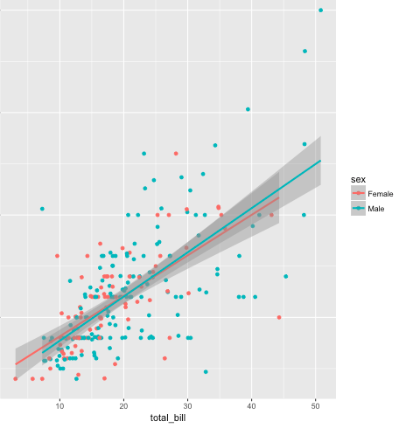
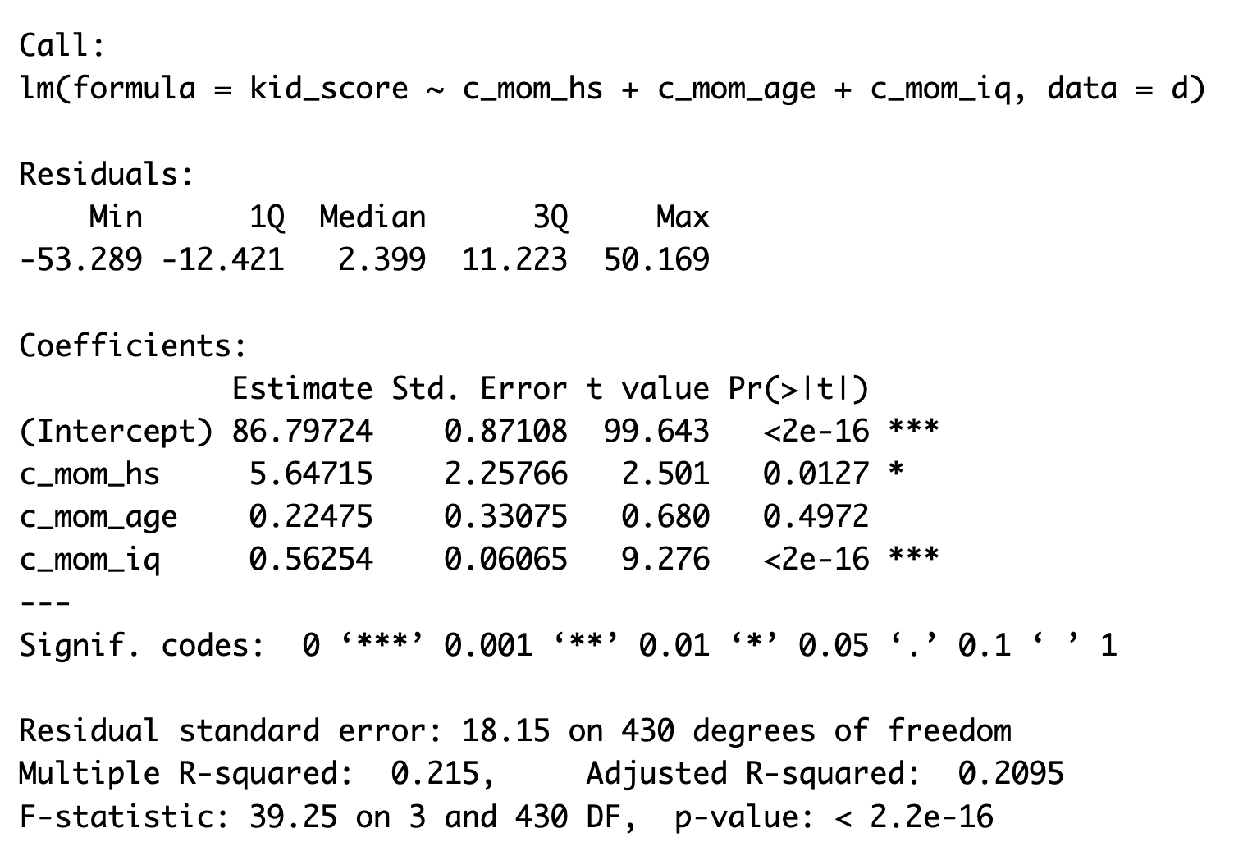
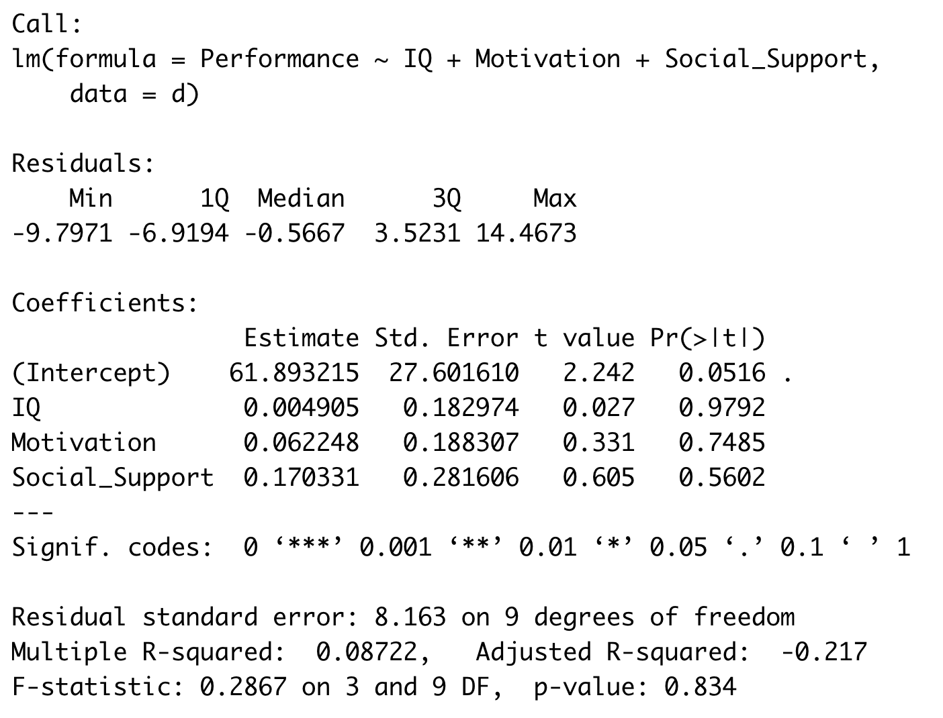
PSYC234 Labs 2 - 4: Example outputs

Slide 3
PSYC234 Labs 2 - 4: What happens
In each lab:
Model output
or
Model plot
In small groups, work backwards to plan the analysis script that produced the model output
Use lab time / staff to check plan
Bring script to the following lab
First part of lab ask more questions
Script swap – with your peers
If you want a chance for feedback, email to me

Slide 4
The role of staff in labs
Get us to check your planning / code / answer your questions / listen to your model interpretations
We will
identify gaps
Tell you that there is an error somewhere with an indication of where to look more closely
Give you hints
Extend your thinking if you are working at your best level already….
We won’t
Give you the answers straight out
Because most of your project experience is going to be about problem solving

Slide 5
This week: Practice in interpreting 3 Models:

Slide 6
Example output with suggestive reporting text
Text = a paragraph reporting model significance, then coefficients (statistics + verbal description).
Example of model significance: The model predicting children’s test scores from mother’s graduation status, mother’s age and IQ was significant (F (3, 430) = 39.25, p < .001, R² = 0.21).
Example text for ‘c_mom_hs’ coefficient:
The difference for whether the mother graduated high school or not is significant (b = 5.65, SE = 2.26, p = .013). Holding all other predictors constant, the difference in scores for a child whose mother finished high school and a child whose mother did not finish high school is 5.64 test points.

Slide 7
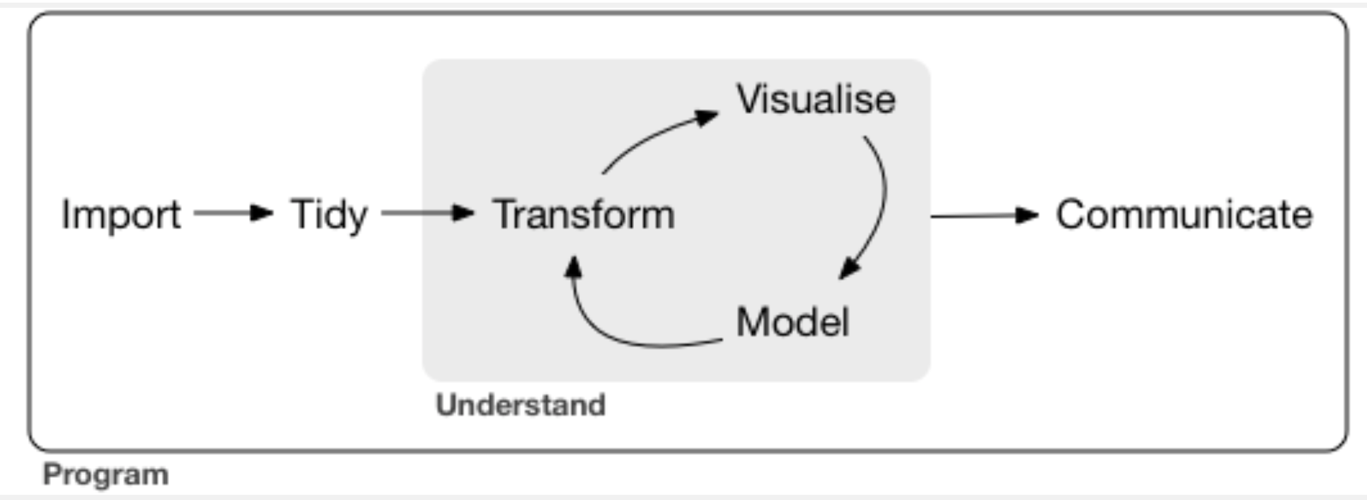
Week 12: Analysing using the workflow

Slide 8
Each stage represents small blocks of code:

Slide 9



Communicate = Descriptive Statistics, model summaries, plots of effects & explanatory text

